Slide 1
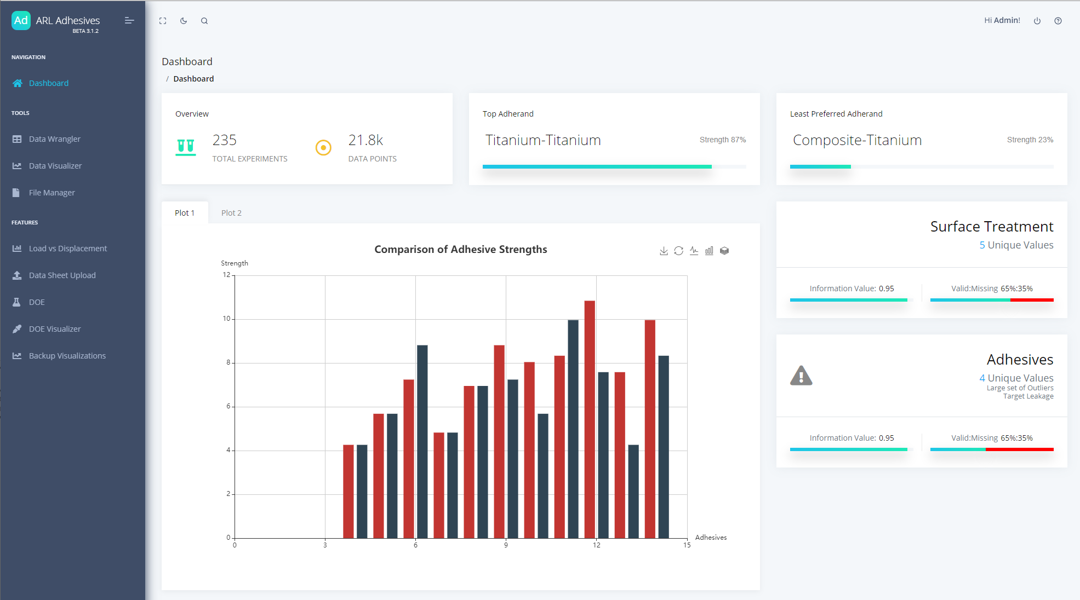
ARL Data Dashboard
Notes:
The following work shown as part of an ongoing project I worked on with the Army Research Lab during my Masters program. On the slide here you can see the homepage of that project, showing what work had been done by previous teams.
We were working with adhesive experimentalists at the Army Research Lab, who wanted to improve their data pipeline around tensile shear testing. For some brief background, this type of test is basically binding two plates with an adhesive, and applying shear force until the adhesive fails and the plates separate. Running these tests can be tedious and they are often repeated by different institutions because data isn’t shared between the suppliers, ARL, and other clients. This results in inefficient resource use and unnecessary costs. To solve this problem, the adhesive group had been working with WPI to create a data dashboard that would be accessible by themselves and other companies in the space, where data could be stored centrally and would also have some tools for light analytics and let users download data to further analyze with their own workflow.

Slide 2


Interactive visualization tool
Explore trends
Drill down
Code and development improvements
Apply more rigid standards
Improve docs + add boilerplate
Encourage better DevOps
Notes:
The project had been running for a few semesters before it was handed to my team. I was assigned to plan and begin initial implementation a specific visualization tool that would let scientists explore trends across experiments as well as drill down into single ones.
Being such an ambitious project, the development process itself was the most important factor in ensuring its quality and timeliness. While working on the visualization, it became increasingly clear to me that the codebase and pipelines would benefit from more rigid standards and organization, better documentation, and by incorporating better DevOps techniques. I took initiative to start making some of these changes, and provided the sponsor with a document describing how future teams could improve on my foundation.
I spent some time speaking with the project sponsor to gather more information about the specific analytical tasks experimentalists were making to help drive my design of the vis tool. After becoming more familiar with the domain and what the users were looking for in the tool, I formalized my design plan, providing expectation for the work I’d do that semester and detailing my future vision for the tool for the next team to complete.
I chose to use D3 for this task mainly for its flexibility in design and interactions, and also because it was already part of the project’s stack.
** All this work was being done in React, and since both libraries want to manipulate DOM in their own separate ways I had to be careful to keep them fairly compartmentalized as to avoid bugs and set a good example for how that type of pattern should be implemented in the future. **

Slide 3
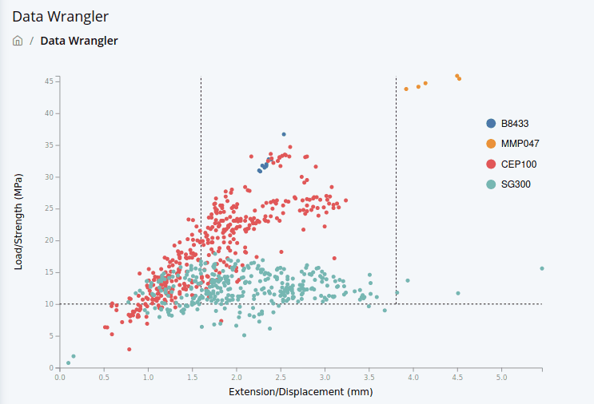
My Contribution
Notes:
The users needed to be able to view trends across experiments, compare experiments at a glance, and view further data related to a single experiment.
I started with a scatter chart that had been established in the standards for these experiments, which plots the force pulling on the plate and the displacement of that plate at the point of failure. Each adhesive was given a unique color to help visualize the overall performance for each one.

Slide 4
Notes:
To help with visibility, I also added functionality to be able to mouse-over an item in the legend to highlight that group.

Slide 5
Notes:
The experimentalists also wanted to be able to select a single experiment and see further information about it.

Slide 6
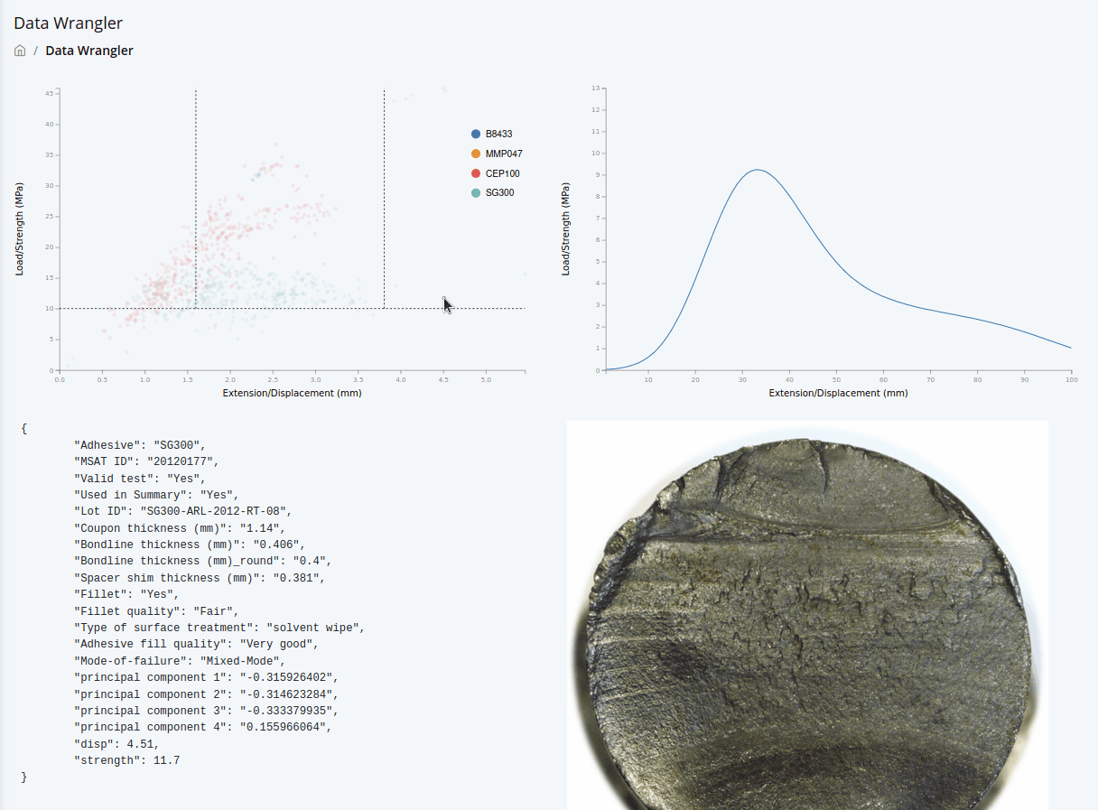
Notes:
Specifically, they wanted to see 3 things:
One was the full data row from which the load and displacement were pulled from, which can be seen on the bottom left.
Sometimes scientists would want to upload a picture of the plate surface after failure, so if an experiment had an associated image it would be shown on the bottom right.
During the experiment, the pull strength and displacement are measured continuously, so scientists also wanted to view this load vs displacement curve which can be seen in the top right.
I also started writing code to allow for a user to selected multiple points, which would cause the failure surface images to appear next to each other and add multiple curves to the load disp chat. I planned for the data in the bottom left to be in a table view so that rows could be filled in for each selected experiment.

Slide 7
Improving the Process
Address and reduce tech debt
Prevent future buildup
Notes:
So that covers the visualization itself, and as I mentioned previously, I noticed some trends in the development process that were leading to lots of tech debt. While working on my visualization tool, I started to address these issues.

Slide 8
Improving the Process
/src: app code
/components
/MyComponent.jsx
/__tests__
/MyComponent.test.js
/styles
/some-styles.scss
/_actions: Redux actions
/_constants: Redux constants
/_containers: Redux containers
/_reducers: Redux reducers
/index.js
/routes.js
/store.js
/webpack: webpack configs
/scripts: build scripts, etc.
/tests: non-component specific tests
Address and reduce tech debt
Prevent future buildup
Apply conventional structure
Notes:
The first thing I thought would benefit the project the most was to provide some structure to the project directory. There was essentially no structure as students had been writing their code in random files and folders with no real direction. I went through the entire codebase, giving functions, components, and files more appropriate names and setting up a directory structure so that each component would be kept near its stylesheet and tests. Almost every file at this point used relative imports, which of course did not work after moving files around. I chose to convert every import across the app into absolute paths so that moving files in the future would require less work.
************
Abs vs relative
imports in a file don’t break if the file is moved
refactor easier, find & replace
locate file easier

Slide 9
Improving the Process
/src: app code
/components
/MyComponent.jsx
/__tests__
/MyComponent.test.js
/styles
/some-styles.scss
/_actions: Redux actions
/_constants: Redux constants
/_containers: Redux containers
/_reducers: Redux reducers
/index.js
/routes.js
/store.js
/webpack: webpack configs
/scripts: build scripts, etc.
/tests: non-component specific tests
Address and reduce tech debt
Prevent future buildup
Apply conventional structure
Redux store
Notes:
Another key part that was missing was a functioning Redux store to manage state across the application, so as part of this restructuring process I added directories for actions, reducers, etc. and began writing a store. The backend for the project had not received very much attention, so I wrote function headers for querying the database when the API endpoints were implemented.
While working on the vis I wanted my components to be scalable and work with the store once it was finalized, so I added placeholder code to work with this new React-Redux pattern.
One feature we wanted to add was to let a user query the data, and have the visualization update accordingly to only include the data returned from their query. This would be possible with the addition of the Redux store, so that when the data was manipulated locally, both the table component running the search and the visualization would be aware of the changes.
I also made similar changes to existing code, so that once data could be retrieved from the database, a user’s search on the data would cause the visualization to only display the data returned from the search.

Slide 10
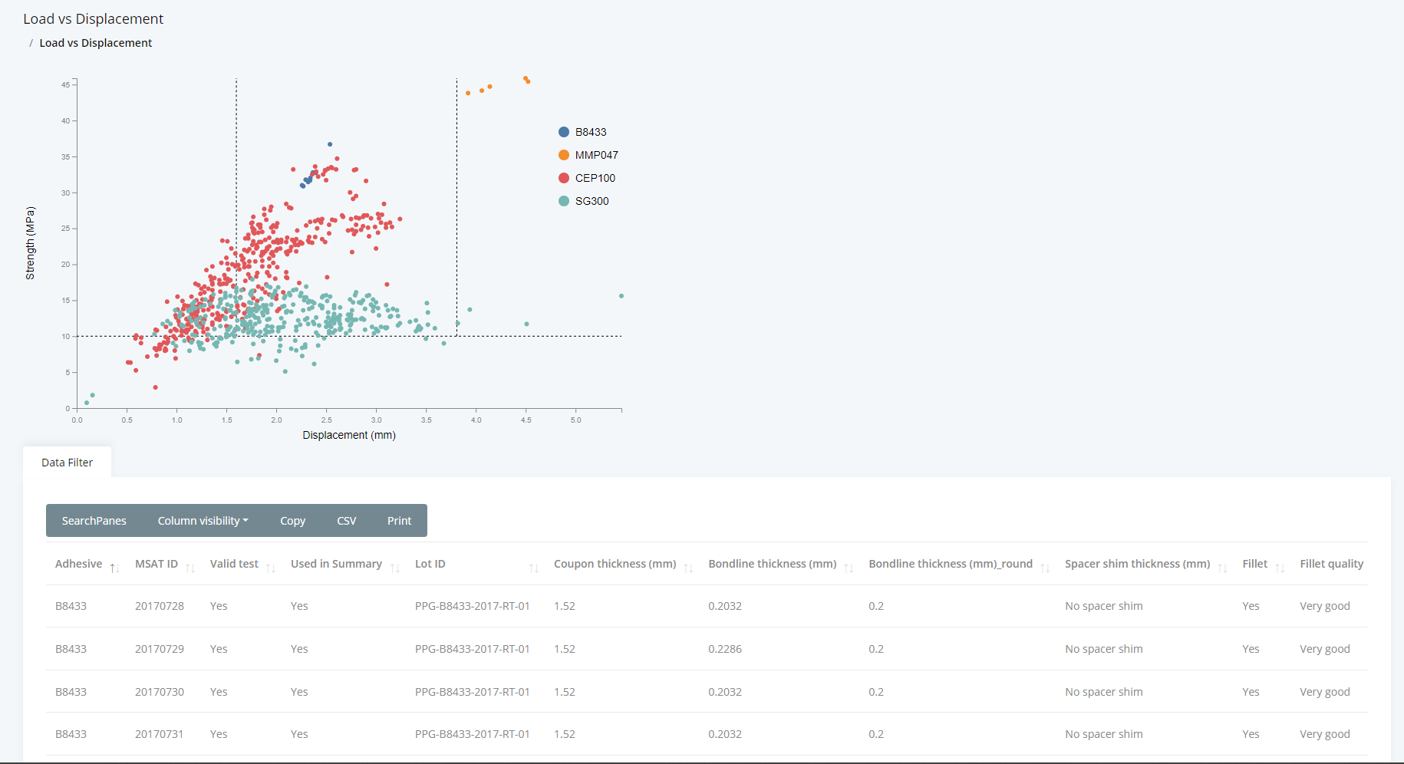
Application of Redux
Notes:
One feature we wanted to add was to let a user query the data, and have the visualization update accordingly to only include the data returned from their query. This would be possible with the addition of the Redux store, so that when the data was manipulated locally here in this table, it would change the state that is also accessible by the vis tool.

Slide 11
Improving the Process
/src: app code
/components
/MyComponent.jsx
/__tests__
/MyComponent.test.js
/styles
/some-styles.scss
/_actions: Redux actions
/_constants: Redux constants
/_containers: Redux containers
/_reducers: Redux reducers
/index.js
/routes.js
/store.js
/webpack: webpack configs
/scripts: build scripts, etc.
/tests: non-component specific tests
Address and reduce tech debt
Prevent future buildup
Apply conventional structure
Redux store
Testing
Notes:
Something very important that was missing throughout the project was adequate testing. I made sure to write tests for the components I wrote, and encouraged the project lead to include an automated build and test procedure so that new changes could be easily validated, and well as to make writing tests a regular part of their development cycle.
There were many other things I wanted to do to improve the development process, so the sponsor requested a document detailing these items for the next team to take over. My suggestions were centered around solidifying the database schema and API as the highest priority, as well as adding tools to ensure quality in new code such as mandating usage of a linter and automated testing on new commit.

Slide 12
Summary
Interactive visualization tool
Created design plan
Wrote working prototype
Engineered for scalability & modularity
Improved development process & codebase
Restructured project
Added Redux functionality
Delivered suggestions for project lead
Notes:
So to recap, at the end of the project I was able to deliver a working prototype for the visualization tool as well as a document explaining my process, detailing future plans, and providing the research that drove those decisions.
I also reorganized the project directory to be more in line with the accepted standards, started work on a Redux store and provided boilerplate for how to interact with it, and delivered my research suggestions for improving the development process in priority order.

